Slide 1




Spotify
DATA ANALYSIS WITH POWER - BI

Slide 2




About Spotify
About Spotify
KEY PEOPLEKEY
Founded : 2006
Project Summary
Problem Statement
Country of Origin: SWEDEN
Key People :
Spotify - Dataset
DANIEL EK
Variable Description
MARTIN LORENTZON
Source
Help
1
Notes:
Photo by Frank Septillion on Unsplash

Slide 3

Problem Statement
About Spotify
This problem statement sets the stage for exploring various aspects of the Spotify dataset.
The objective of this analysis is to identify the importance of patterns, trends that can help the musicians make informed decisions.
Project Summary
Problem Statement
Spotify - Dataset
Variable Description
Streams
Source
Help
Notes:
Photo by melanie van leeuwen on Unsplash
Photo by te nguyen on Unsplash
Photo by claudia raya on Unsplash
Photo by soundtrap on Unsplash

Slide 4


Project Summary
About Spotify
Project Summary
Musicians and Music Labels –
Helping them connect more effectively with their audience and grow their fan base
Problem Statement
Spotify - Dataset
Variable Description
We will be uncovering the patterns, correlations, and trends within the dataset
Factors
Factors
Source
Audience Demographics
Geographic Insights
Help
Listening Behaviour
Engagement Metrics
This project demonstrates the power of data analytics in unlocking actionable insights innovation in the music streaming industry
Playlist Inclusions:
Fan Engagement
Notes:
Photo by Frank Septillion on Unsplash
Photo by Joshua Fuller on Unsplash

Slide 5
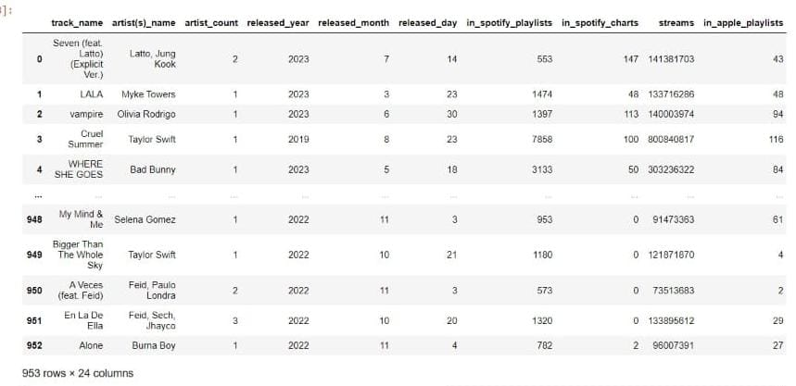
Spotify - Dataset
About Spotify
Project Summary
Problem Statement
Spotify - Dataset
Variable Description
Source
Help

Slide 6


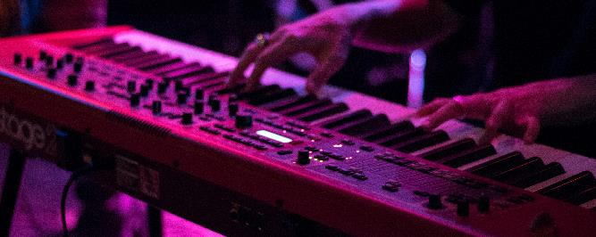

Variable Description
Track_name: Name of the song
Artist(s)_name: Name of the artist(s) of the song
Artist_count: Number of artists contributing to the song
Released_year: Year when the song was released
Released_month: Month when the song was released
Released_day: Day of the month when the song was released
In_spotify_playlists: Number of Spotify playlists the song is included in
In_spotify_charts: Presence and rank of the song on Spotify charts
Streams: Total number of streams on Spotify
In_apple_playlists: Number of Apple Music playlists the song is included in
In_apple_charts: Presence and rank of the song on Apple Music charts
In_deezer_playlists: Number of Deezer playlists the song is included in
In_deezer_charts: Presence and rank of the song on Deezer charts
In_shazam_charts: Presence and rank of the song on Shazam charts
Bpm: Beats per minute, a measure of song tempo
Key: Key of the song
Mode: Mode of the song (major or minor)
Danceability_%: Percentage indicating how suitable the song is for dancing
Valence_%: Positivity of the song's musical content
Energy_%: Perceived energy level of the song
Acousticness_%: Amount of acoustic sound in the song
Instrumentalness_%: Amount of instrumental content in the song
Liveness_%: Presence of live performance elements
Speechiness_%: Amount of spoken words in the song
About Spotify
Project Summary
Problem Statement
Spotify - Dataset
Variable Description
Source
Help
Notes:
Photo by freestocks on Unsplash
Photo by Martin Hexeberg on Unsplash
Photo by Alexander Popov on Unsplash
Photo by Matthias Wagner on Unsplash

Slide 7
Source
About Spotify
Source Link :
kaggle datasets download -d ahmedsayed564/spotify-songs-2023
Project Summary
DATASET Link :
spotify-2023.csv
Problem Statement
Spotify - Dataset
Variable Description
Source
Help
Notes:
Photo by stefano pollio on Unsplash
Photo by jonathan chng on Unsplash
Photo by patrick tomasso on Unsplash
Photo by leo wieling on Unsplash
Photo by israel palacio on Unsplash

Slide 8

Potential Use Cases
Music analysis
Artist analysis
Temporal trends

Slide 9
Insights
Spotify are back with their new tracks and artists, on the whole 2022 has been a good year with highest number of tracks released.
The Major reason for Spotify coming back in trend is because of addition of artists like Taylor Swift, Bad Bunny, Drake, The Weekend and Others.
Also now a days, It can be expected that Low energy, slow songs are more danceable by people.
Particularly, on the month’s of January and September there is more number of streams comparatively.
Over the year’s average energy level of all the songs in all the keynotes is above 50%, and it has a good streaming score.

Slide 10
Recommendations
Spotify can add more slow/calm songs and artists who create such songs as they are coming trend and also becoming more danceable.
Artist can maintain the bpm range of Medium-fast (110-130 BPM), as it’s getting in trend.
Tracks can be released during the starting of the weekend, and during the first quarter of the year.
Spotify can have a special feature section for their top artists where users can find all top songs quickly.

Slide 11

Thank You for listening !

